Slide 1

ASYMPTOTIC NOTATION :
Big O, Omega, Theta Notation
MENTOR - PRIYA BHATIA

Slide 2


Big O Notation
Let f(n) and g(n) be two positive functions. Then,
f(n) = O(g(n))
if f(n) <= c.g(n) ; for all n, n >= n_0 such that there exists two positive constants.
c > 0 , n_0 >= 1
For example : a = O(b)
Meaning : b is somehow greater than a after taking c help.

Slide 3
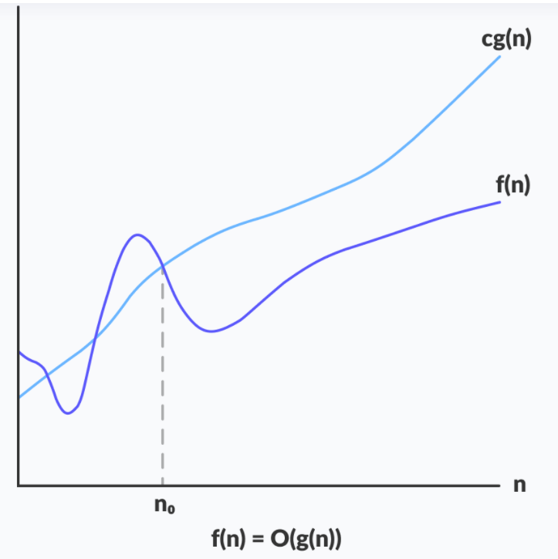

Graphical Representation of Big O
F(n) = O(g(n))
If there exists a positive constant c such that it c >= 0, for sufficiently large value of n.
For any value of n, the running time of an algorithm does not cross the time provided by O(g(n))

Slide 4


Problem 1
f(n) = 5n
g(n) = n
f(n) = O(g(n))
For what value of c above statement holds true?

Slide 5



Problem 2
f(n) = n^2 + n + 10
g(n) = n^2
f(n) = O(g(n))
For what value of c above statement holds true?

Slide 6











Problem 3
f(n) = n^2
g(n) = n
f(n) = O(g(n))
For what value of c above statement holds true?

Slide 7





Omega Notation
Let f(n) and g(n) be two positive functions. Then,
f(n) = Omega(g(n))
if f(n) >= c.g(n) ; for all n, n >= n_0 such that there exists two positive constants.
c > 0 , n_0 >= 1
For example : a = Omega(b)
Meaning : b is somehow lesser than a after taking c help.

Slide 8
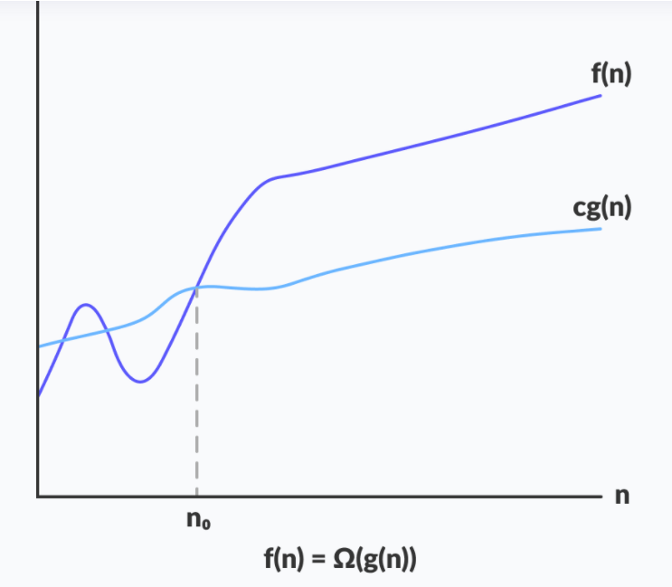

Graphical Representation of Omega Notation
If there exists a constant c such that it lies above cg(n), for sufficiently large value of n.
For any value of n, the minimum time required by the algorithm is given by Omega(g(n))

Slide 9

Problem 1
f(n) = n
g(n) = 5n
f(n) = Omega(g(n))
For what value of c above statement holds true?

Slide 10









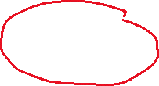
Problem 2
f(n) = n^2
g(n) = n^2 + n + 10
f(n) = Omega(g(n))
For what value of c above statement holds true?

Slide 11
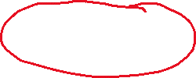


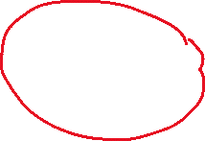
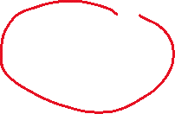
Problem 3
f(n) = n
g(n) = n^2
f(n) = Omega(g(n))
For what value of c above statement holds true?

Slide 12

Theta Notation
Let f(n) and g(n) be two positive functions. Then,
f(n) = Theta(g(n))
if f(n) >= c_1.g(n) and f(n) <= c_2.g(n) ;
for all n, n >= n_0 such that there exists two positive constants.
c_1 > 0 , c_2>0, n_0 >= 1

Slide 13
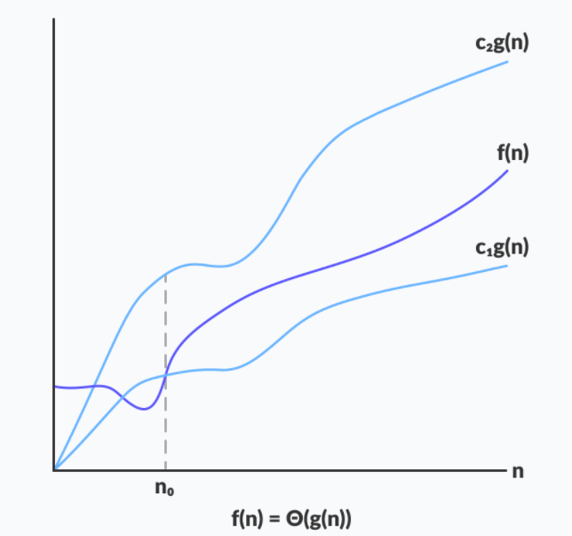

Graphical Representation of Theta Notation
If there exists positive constants c1 and c2 such that it can be sandwiched between c1g(n) and c2g(n), for sufficiently large value of n.
If a function lies anywhere in between c1g(n) and c2g(n) for all n >= n_0, then f(n) is said to be asymptotically tight bound.

Slide 14


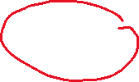




Problem 1
f(n) = n
g(n) = 5n
f(n) = Theta(g(n))
For what value of c_1 and c_2 above statement holds true?

Slide 15







Problem 2
f(n) = n
g(n) = n
f(n) = Theta(g(n))
For what value of c_1 and c_2 above statement holds true?

Slide 16

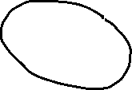

Problem 3
f(n) = n
g(n) = n^2
f(n) = Theta(g(n))
For what value of c_1 and c_2 above statement holds true?

Slide 17
Problems Related to Asymptotic Notation

Slide 18


Slide 19






Slide 21



Properties of Logarithms :

Slide 22






Slide 23
Thank You

